Slide 1


Logging with ASP.NET Core
Damien Bowden Microsoft MVP
https://damienbod.com
@damien_bod

Slide 2
Why Logging?
…explain logging in ASP.NET Core & .NET Core
…how to add third party loggers

Slide 3
What Microsoft provides
Abstraction layer for logging in .NET Core
Wrapper for your favourite logger
Decouples your logging provider from your application

Slide 4
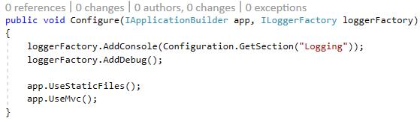
Startup.cs

Slide 5
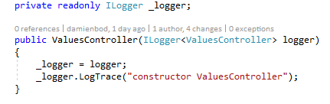
In your Class

Slide 6
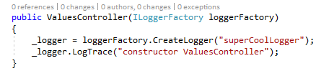
In your Class

Slide 7
Log Levels
Trace = 0
Debug = 1
Information = 2
Warning = 3
Error = 4
Critical = 5
Notes:
Trace = 0
For information that is valuable only to a developer debugging an issue. These messages may contain sensitive application data and so should not be enabled in a production environment.
Debug = 1
For information that has short-term usefulness during development and debugging.
Information = 2
For tracking the general flow of the application. These logs typically have some long-term value.
Warning = 3
For abnormal or unexpected events in the application flow. These may include errors or other conditions that do not cause the application to stop, but which may need to be investigated. Handled exceptions are a common place to use the Warning log level.
Error = 4
For errors and exceptions that cannot be handled. These messages indicate a failure in the current activity or operation (such as the current HTTP request), not an application-wide failure.
Critical = 5
Logs that describe an unrecoverable application or system crash, or a catastrophic failure that requires immediate attention.

Slide 8
Default Logging Providers
Console
Debug
EventSource
EventLog
TraceSource
Azure App Service

Slide 9






Third Party Logging, Structured Logging
Serilog
NLog
elmah io

Slide 10
Third Party Logging, Structured Logging
Seq
Elasticsearch (ELK)
SQL databases
elmah.io
Syslog
ColoredConsole
Files

Slide 11
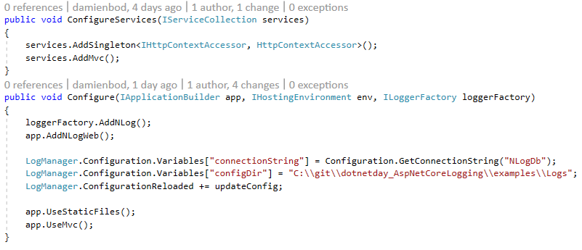

Example: NLog

Slide 12
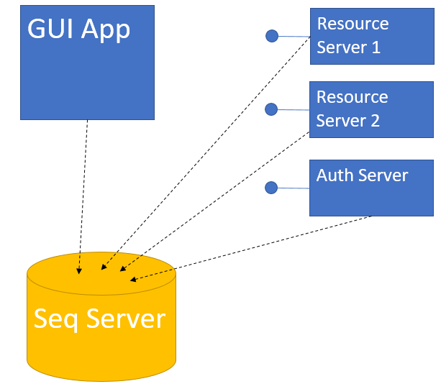
App Demo

Slide 13
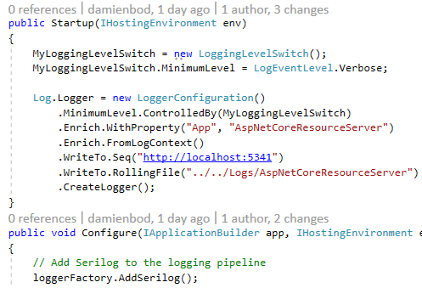
ASP.NET Core Serilog
Serilog
Serilog.Extensions.Logging
Serilog.Sinks.Seq

Slide 14
Structured Logging
“Logs are worthless if you can’t use them”
Notes:
A language-neutral specification for 1) capturing, and 2) rendering, structured log events in a format that’s both human-friendly and machine-readable.

Slide 15
Plan your logging architecture and review the logs / log levels

Slide 16
Resources and Links
Examples https://github/damienbod/AspNetCoreLogging
Microsoft https://docs.microsoft.com/en-us/aspnet/core/fundamentals/logging
Microsoft https://github.com/aspnet/Logging/wiki/Guidelines
Microsoft https://github.com/aspnet/Logging
Seq http://blog.getseq.net/
Serilog https://serilog.net/
Serilog https://nblumhardt.com/2014/10/dynamically-changing-the-serilog-level/
NLog http://nlog-project.org/
NLog https://damienbod.com/2016/08/17/asp-net-core-logging-with-nlog-and-microsoft-sql-server/
NLog https://tpodolak.com/blog/2017/02/18/asp-net-core-tracking-flow-requests-nlog/
ELK https://www.elastic.co/webinars/introduction-elk-stack
elmah.io https://elmah.io/
Structured Logging https://messagetemplates.org/
Syslog https://github.com/mguinness/syslog-framework-logging
PerfView https://www.microsoft.com/en-us/download/details.aspx?id=28567

Slide 17
Thank you

